Slide 1
Principes SOLID
Partie 1

Slide 2
Qu’est-ce c’est?
Acronyme de :
Single Responsibility Principle (SRP)
Open/Closed Principle (OCP)
Liskov Substitution Principle (LSP)
Interface Segregation Principle (ISP)
Dependency Inversion Principle (DIP)

Slide 3
Pourquoi?
➔ Meilleure maintenabilité
➔ Plus adaptable
➔ Plus testable
➔ Plus granulaire

Slide 4
Single Responsibility Principle

Slide 5
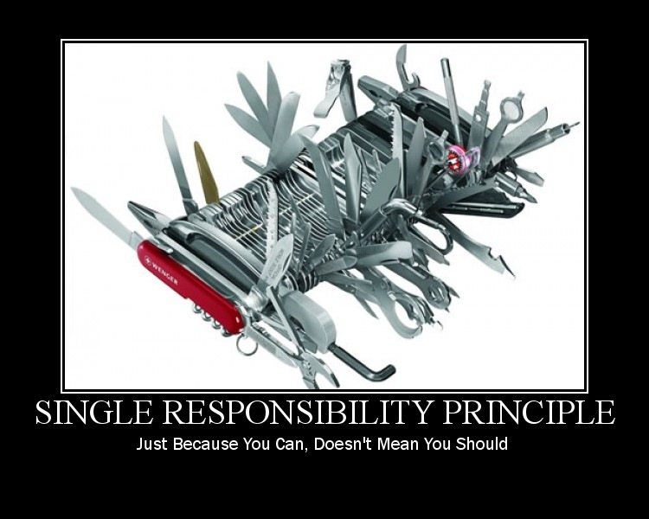

Slide 6
Single Responsibilty Principle
“A class should have only one reason to change”

Slide 7
Démo

Slide 8
Sources
www.codeproject.com/Articles/93369/How-I-explained-OOD-to-my-wife
https://code.tutsplus.com/tutorials/solid-part-1-the-single-responsibility-principle--net-36074
https://lostechies.com/chadmyers/2008/03/08/pablo-s-topic-of-the-month-march-solid-principles/
http://www.codeproject.com/Articles/1009577/Solid-Principle-In-Detail
Plus avancé: https://codurance.com/software-craftsmanship/2016/06/22/Single-Responsibility-Principle/
Demotivators: https://lostechies.com/derickbailey/2009/02/11/solid-development-principles-in-motivational-pictures/

